Slide 1




Ethiopia HIV Testing Service Strategies
RTCQI Best Practice Workshop
June 03-07, 2024
Cape town, South Africa

Slide 2

Outline
Background
Overview of HIV Testing Services
Evolution of HIV Testing service in Ethiopia
Implementation of HIV status verifications prior to ART
HIV Testing Strategies / Technologies
Development of HIV Testing Algorithm
Rationale for Algorithm Adoption
Measures to ensure the adherence to testing strategy
Conclusion
Lesson learned

Slide 3
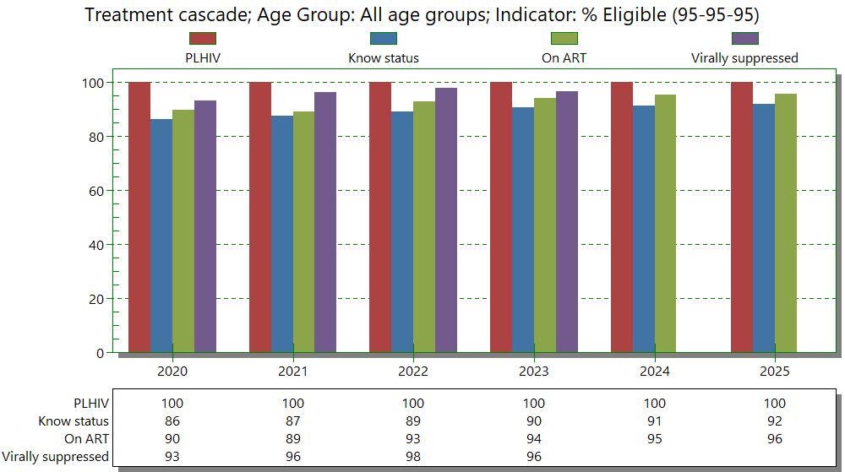
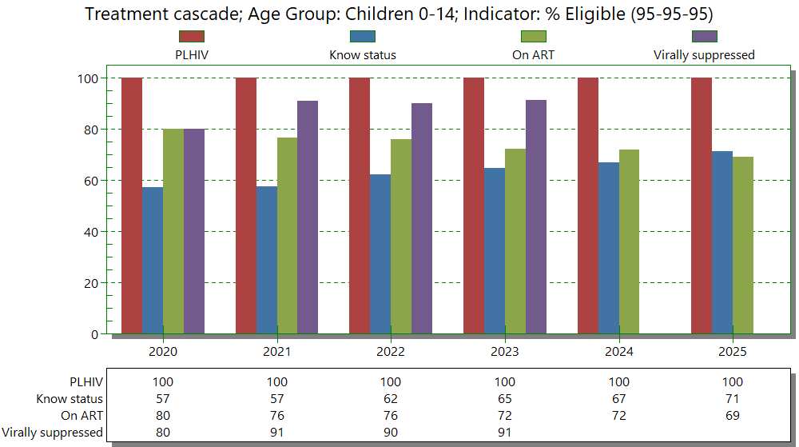
Background-Treatment cascade-2023 spectrum
The three 95 status as lower among children

Slide 4
OVERVIEW OF HIV TESTING SERVICES
1987
HCT started
1989
in country training conducted for hospital health professionals.
1996
HCT guideline developed
1998
VCT made available following the launch of the National HIV/AIDS Policy in 1998.
2000
VCT guidelines developed by HAPCO and MOH and revised in 2002.
2002
Same day VCT service using rapid testing introduced.
2003
VCT services become widely available
2006
VCT guideline updated & launched to improve both HF & community-based HCT Services.
2016
Targeted testing using HIV risk screening tool for 15 Eligible clients
2018
Index testing service /Partner notification services
2018
Key population friendly services
2019
Social network testing service
HIVST for Key populations, partner of index client and priority populations
2024
Dual HIV/syphilis rapid test
2019
Social Network Testing services (SNS)
Dec 2006
PITC PICT provider-initiated HIV testing and counseling
Notes:
HIV 1st case =1984
1st Admission = 1986
HIV epidemic = 1970 – 1980
HCT = 1987
Training = 1989
VCT = 1988
PMTCT = 2001

Slide 5

The first instances of HIV testing in Ethiopia date back to the early response to the HIV/AIDS epidemic.
The evolution of HIV testing algorithms in Ethiopia from 1980 to the present has been marked by significant advancements and adaptations to meet the country’s specific needs and challenges.
1980’s: HIV testing began with the use of the first-generation ELISA tests, which had longer window period and lower sensitivity.
The first HIV testing in Ethiopia commenced using ELISA (second generation)
1990’s: Second-generation ELISA tests were introduced, improving the detection of HIV antibodies ,reducing window period, accuracy & specificity
2000’s: Rapid Diagnostic Tests (RDTs), allowing for quicker and more accessible HIV testing, especially in remote areas.

Slide 6

Transition from laboratory-based HIV testing to POC testing in Ethiopia
HIV testing, primarily relied on laboratory-based tests. i.e., enzyme-linked immunosorbent assay (ELISA) before 2000.
The evolution of HIV testing technologies has revolutionized the ﬁeld, providing faster and more accurate results. From ELISA to POC tests, these innovations have transformed the landscape of HIV diagnosis and management.
Introduction of Rapid Diagnostic Tests (RDTs):
  To improve access and decentralize testing, Ethiopia adopted rapid diagnostic tests (RDTs) in the 2000’s
  RDTs allowed for point-of-care testing, providing results within minutes
Notes:
These tests were conducted in centralized laboratories, often requiring blood samples to be sent to higher-tier health facilities for analysis. While accurate, this approach had limitations in terms of accessibility, especially for people in remote areas.
Health posts, clinics, and community health centers began using RDTs, making testing more accessible to the population.
Rapid HIV testing's
Tie-breaker algorithm using 3 RDTs in series
Serial HIV testing algorithms
EID test → Point of care testing.
Parallel HIV testing algorithms.
HIV self testing.
Dual HIV/syphilis rapid testing strategy and algorithm for ANC

Slide 7
Development of HIV Testing Algorithm
1 | This algorithm incorporated a tiebreaker third test | Determine, Capilus, and UniGold,
2 | Tie breaker algorithm | KHB, STAT-PAK, and Uni-Gold
3 | Serial algorithm (2016 interim algorithm) | First Response HIV 1-2.0, Uni-Gold HIV, VIKIA HIV-1/2:
4 | Serial algorithm (2018) | Stat pack Abon SD Biolin
5 | Serial algorithm Currently, utilizing (2023) | One Step First response Uni-Gold
Currently country employed a serial strategy with Three reactive Rapid Diagnostic Test (RDT) results for reporting positive status

Slide 8
Rationale for Algorithm Adoption
Recent algorithms adopted is based on WHO 2019 guideline
Emphasis was placed on achieving a high positive predictive value (PPV) to enhance reliability of HIV testing within the country.
Given Ethiopia's relatively low HIV prevalence (0.9%) the national HIV strategy or algorithm was adjusted accordingly
Since its adoption, Ethiopia has been utilizing the three-reactive RDT testing strategy for HIV diagnosis.
The algorithm aimed to ensure testing accuracy, considering the risk of false positive results due to cross-reactivity

Slide 9
Process for the development of the National testing algorithm
Establishment of National TWG
Selection of Test kits
Evaluation
Develop Algorithm
♦Literature review
♦ Protocol preparation
♦ Preparation of criteria for RTK selection
♦ Public announcement for suppliers
♦ Receive RTK for evaluation
♦ Tester's training
♦ Conduct evaluation
♦Data collection and analysis
♦ Select tests based on the evaluation
♦ Develop algorithm
♦ Ethical approval

Slide 10
HIV Testing Strategies
Before any test is adopted for use, a series of key steps were undertaken. These steps include:
Identifying appropriate tests
Developing an algorithm
Building consensus
Developing policy
Bringing into the national scale
Reviewing testing algorithms every 3-5 Years
key steps in the adoption of HIV strategy

Slide 11
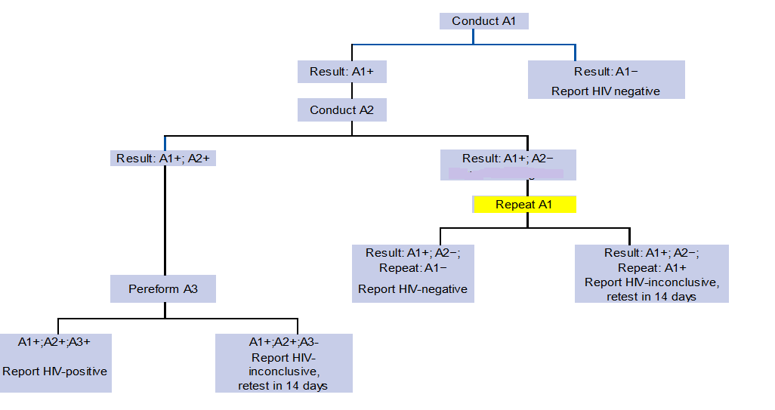
Current- HIV testing Algorithms
A1: Assay 1 (first test);
A2: Assay 2 (second test);
A3: Assay 3 (third test).
Assays are HIV rapid diagnostic test (RDTs)

Slide 12
Implementation of HIV status verifications prior to ART initiation
National HIV Program recommends retesting of all people newly and previously diagnosed with HIV before enrolling them into care
Retesting performed to all clients diagnosed as HIV-positive/ verification testing
With a second specimen and a different provider using the same testing strategy and algorithm
Implemented across all ART provision health facility as part of standard care
Providers informed about the strategy and trained in SOPs, Regular supervision and monitoring conducted
The implementation of retesting policy have been outstanding, with all PLHIV getting retested for verification of HIV diagnosis before starting ART

Slide 13
National Efforts to Enhance the Quality of HIV Testing Services
Standardization of Testing Procedures
Advanced Training for HCPs
Establishing rigorous QA & QC programs
Accreditation and Certification
Use of Advanced Testing Technologies
Patient-Centered Care Approaches
Facilities and resources
Accessibility and affordability
Client satisfaction
Protocol adherence
Enhanced Data Management Systems
Regular Audits & Evaluations
Quality Assurance Programs
Infection prevention practices
Notes:
Standardization of Testing Procedures
Implementing uniform testing protocols across all testing sites to ensure consistency and reliability of results
Advanced Training for Healthcare Providers
Providing comprehensive training for healthcare professionals on the latest testing technologies and best practices to ensure high-quality service delivery
Quality Assurance Programs
Establishing rigorous quality assurance and control programs to regularly monitor and improve testing accuracy and laboratory practices
Accreditation and Certification
Requiring accreditation and certification of laboratories and testing facilities to maintain high standards of operation and service
Use of Advanced Testing Technologies
Integrating the latest diagnostic technologies, including fourth-generation HIV tests and point-of-care testing, to enhance detection and reduce window periods
Enhanced Data Management Systems
Implementing advanced data management systems to track testing outcomes, identify areas for improvement, and ensure follow-up care
Patient-Centered Care Approaches
Ensuring that HIV testing services are patient-centered, with a focus on confidentiality, counseling, and linkage to care for those who test positive/negative
Regular Audits and Evaluations
Conducting regular audits and evaluations of testing sites to ensure compliance with national standards and identify opportunities for quality improvement
Periodic assessments addressing
Counselors' training and ongoing education
Ensuring counselors receive standardized training and refresher courses approved by the Federal Ministry of Health (MOH)
Facilities and resources
Assessing adequacy of physical space ensuring privacy, availability of necessary supplies, and support tools for service provision
Accessibility and affordability
Ensuring services are within reach of the target population
Client satisfaction
Measuring satisfaction levels through feedback mechanisms
Protocol adherence
Confirming counseling and testing sessions are conducted according to nationally approved protocols
14. Infection prevention practices
Implementing and monitoring infection prevention measures
Trained supervisors ensure:
Counselors' training and adherence to protocols
Regularly assessing if counselors receive standard training and follow counseling and testing protocols
In-person delivery of HIV test results
Ensuring test results are given in person during post-test counseling sessions.
Ensuring adherence to quality criteria, validated test kits, staff training, accurate materials, and infection prevention
Valid testing algorithm
Ensuring sensitivity and specificity of testing algorithms
Lab procedures
Observing standard operating procedures in the laboratory

Slide 14
Measures to ensure the adherence to testing strategy
Proficiency testing
Conducting on-site evaluations
Use of standardized logbook.
Technical support for HTS service quality-
  Providing ongoing technical support to ensure high-quality service delivery
Continuous Training and Capacity Building
Notes:
External Quality Control
Regular proficiency testing:
Sending a percentage of samples to regional laboratories for external quality control
External sample evaluation
Conducting on-site evaluations and proficiency testing for sites not meeting the monthly testing threshold
Additional support for failing sites
Providing technical supervision and support for sites failing proficiency tests
Quality Assurance in country
Proficiency testing- Regularly evaluating proficiency testing
Central lab quality control- Implementing quality control measures at central laboratories
Standardized logbook- Maintaining standardized records of testing procedures and results
Technical support for HTS service quality- Providing ongoing technical support to ensure high-quality service delivery

Slide 15
Conclusion
Ethiopia demonstrates dedication and resilience against HIV by advancing testing techniques and algorithms
Testing protocols are aligned with WHO guidelines and national prevalence rates, reducing misdiagnoses.
Improved accuracy and reliability of HIV testing support better public health outcomes and reduce HIV/AIDS burden.
Innovations in testing technologies enhance accuracy, speed, and accessibility, aiding early detection and care.
Notes:
Ethiopia's commitment to advancing testing techniques and algorithm development reflects a dedication and showcasing resilience against HIV/AIDS epidemic.
The evolution of HIV testing strategies in Ethiopia underscores the nation's proactive approach to addressing the dynamic challenges of the HIV epidemic
By adapting testing protocols to align with WHO guidelines and national prevalence rates, Ethiopia ensures the integrity of HIV diagnosis while minimizing the risk of false-positive results
Enhance the accuracy and reliability of HIV testing, contribute to the broader goals of improving public health outcomes and reducing the burden of HIV/AIDS
Ethiopia's ongoing commitment to innovation and responsiveness in HIV testing serves as a cornerstone in the country's comprehensive approach to HIV prevention, treatment, and care.

Slide 16
Lesson learned
Early Detection & Treatment
Training and Standardization
Quality Improvement Initiatives
Leveraging partnerships
Continuous Evaluation & Improvement
Establish robust monitoring and evaluation
Data Utilization
Sustainability Planning
Notes:
Early Detection and Treatment:
The use and progress of the testing technologies underscored the significance of early detection for timely initiation of treatment, which significantly improve health outcomes and reduce the risk of transmission.
Training and Standardization
Investing in comprehensive and standardized training for counselors and healthcare providers to ensure consistent service delivery and adherence to protocols.
Quality Improvement Initiatives
Implement quality improvement initiatives based on regular feedback from clients and providers, fostering a culture of accountability and excellence
E.g. ICT learning sites…. (Helps offer 100% untested contacts clearance of
Leveraging partnerships to maximize impact and reach in quality management endeavors
Continuous Evaluation and Improvement:
The continuous evaluation of testing strategies and technologies, as well as the willingness to make necessary adjustments, has been crucial in enhancing the effectiveness of Ethiopia’s HIV response.
Monitoring and Evaluation
Establish robust monitoring and evaluation mechanisms to track progress, identify areas for improvement, and celebrate successes in quality assurance and control
Data Utilization- Harnessing the power of data to inform decision-making and drive targeted interventions
Sustainability Planning
Importance of sustainability plans to ensure
Long term viability of quality management efforts
Securing funding and support beyond initial implementation phases
Integration of Best Practices
Adapting strategies to local contexts and evolving needs

Slide 17

Way forward
Moving forward, it is essential to continue refining these strategies and technologies, leveraging advancements in medical science and technology, and fostering international collaborations.

Slide 18
THANK YOU

